Slide 1

NFA Simulator
Mohid raheel khan (23k-3000-)
Hassan nafees (23k-0769)
Aaqib Shivji (23k-0625)

Slide 2
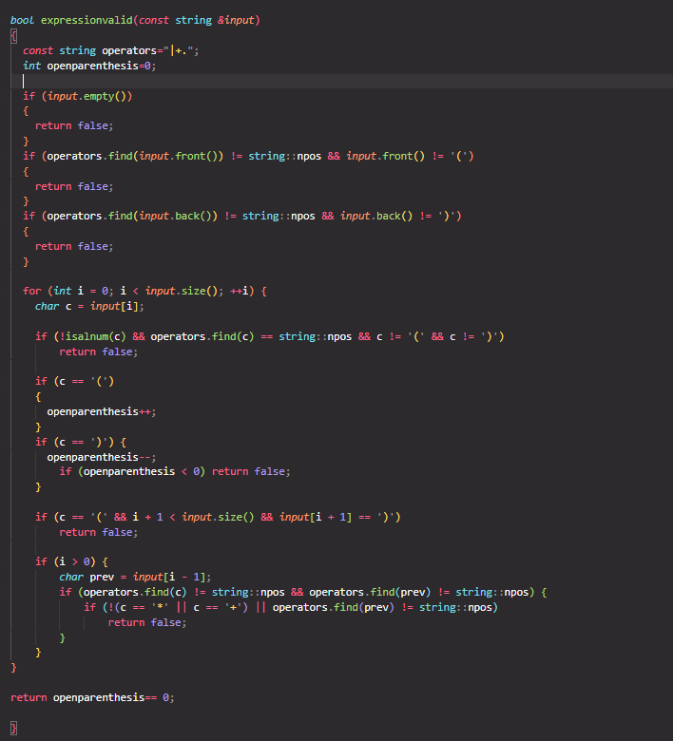

Slide 3
Explanation:
The purpose of this function is to check if the string is valid or not
It keeps the count to match parenthesis
If the string is empty so it will return false
Return true only when it checks pass and all parenthesis is valid.

Slide 4
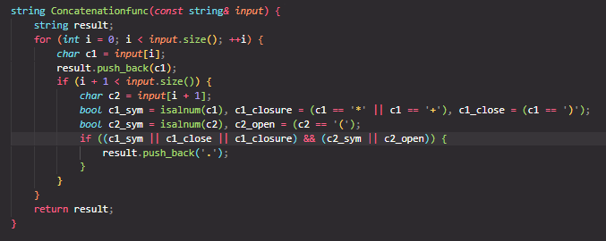

Slide 5
Explanation:
The purpose is to insert “ .” in the regular expression where it is implied.
As in regular expression “ . ” is implicit ,for infix to postfix it is very crucial as to respect operators precedence.
It traverse through loop character by character
C1 is the current character while c2 is the next character
If the valid condition is found it inserts a dot between them and returns the new string .

Slide 6
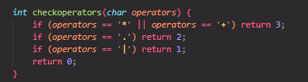

Slide 7
Explanation:
It is a helper function for infix to postfix
It returns the precedence value of the operators

Slide 8
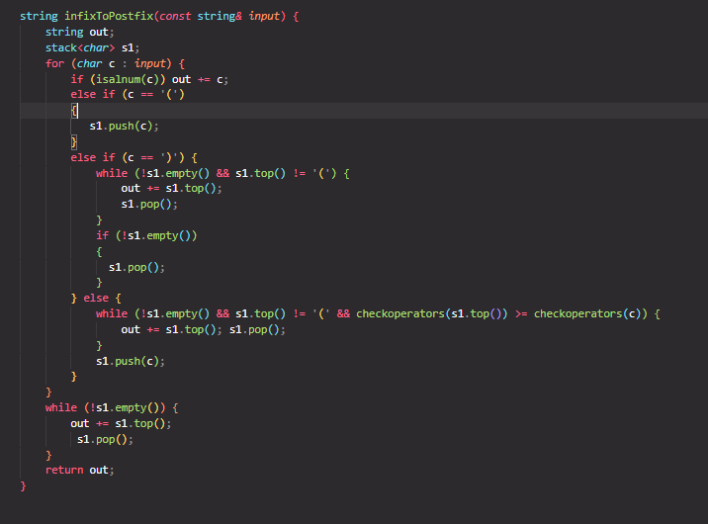

Slide 9
Explanation:
It converts the regular expression into infix to postfix.
‘(‘ is pushed to the stacks and ‘)’ triggers the popping function until the ‘(‘ is not found.
Operators are popped from the stack if the top has higher or equal precedence.
Return the postfix expression.
Postfix is much easier for nfa. the function which builds dfa reads the postfix and build fragments accordingly. This avoids dealing with precedence and operators in this step.

Slide 10
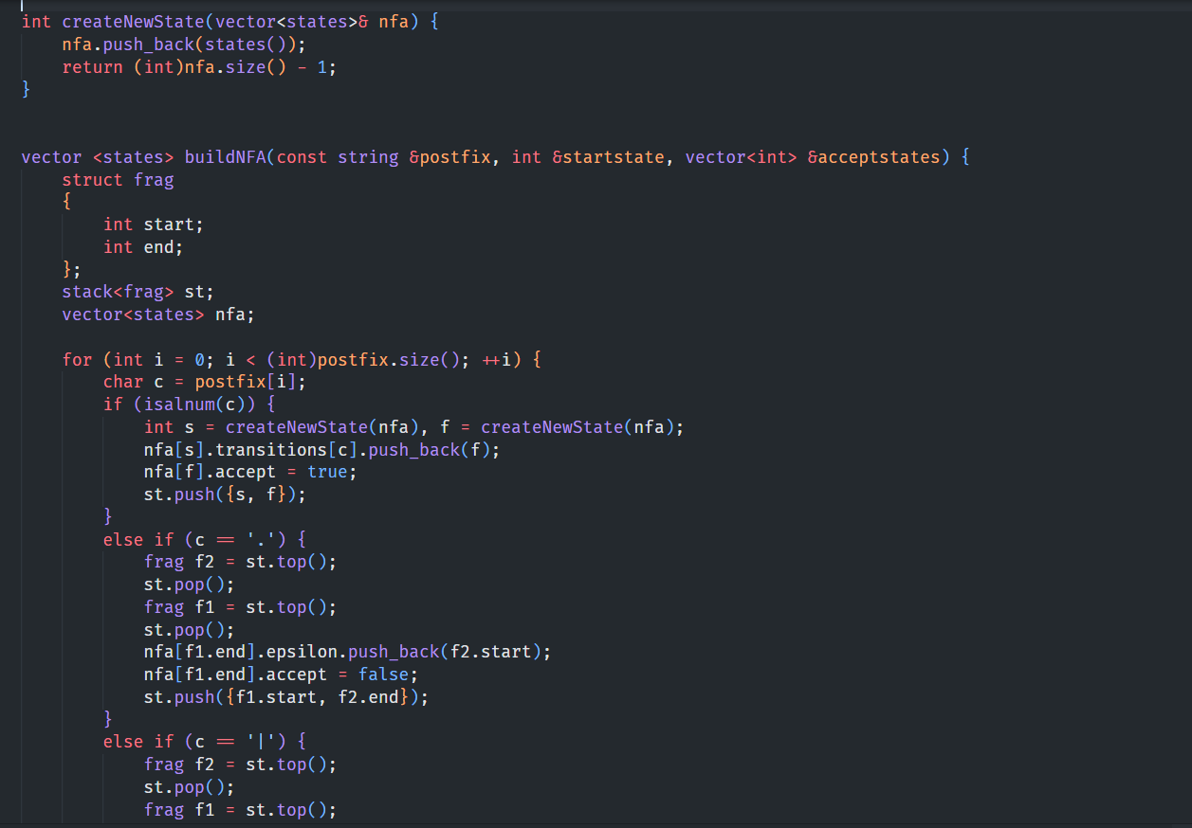

Slide 11
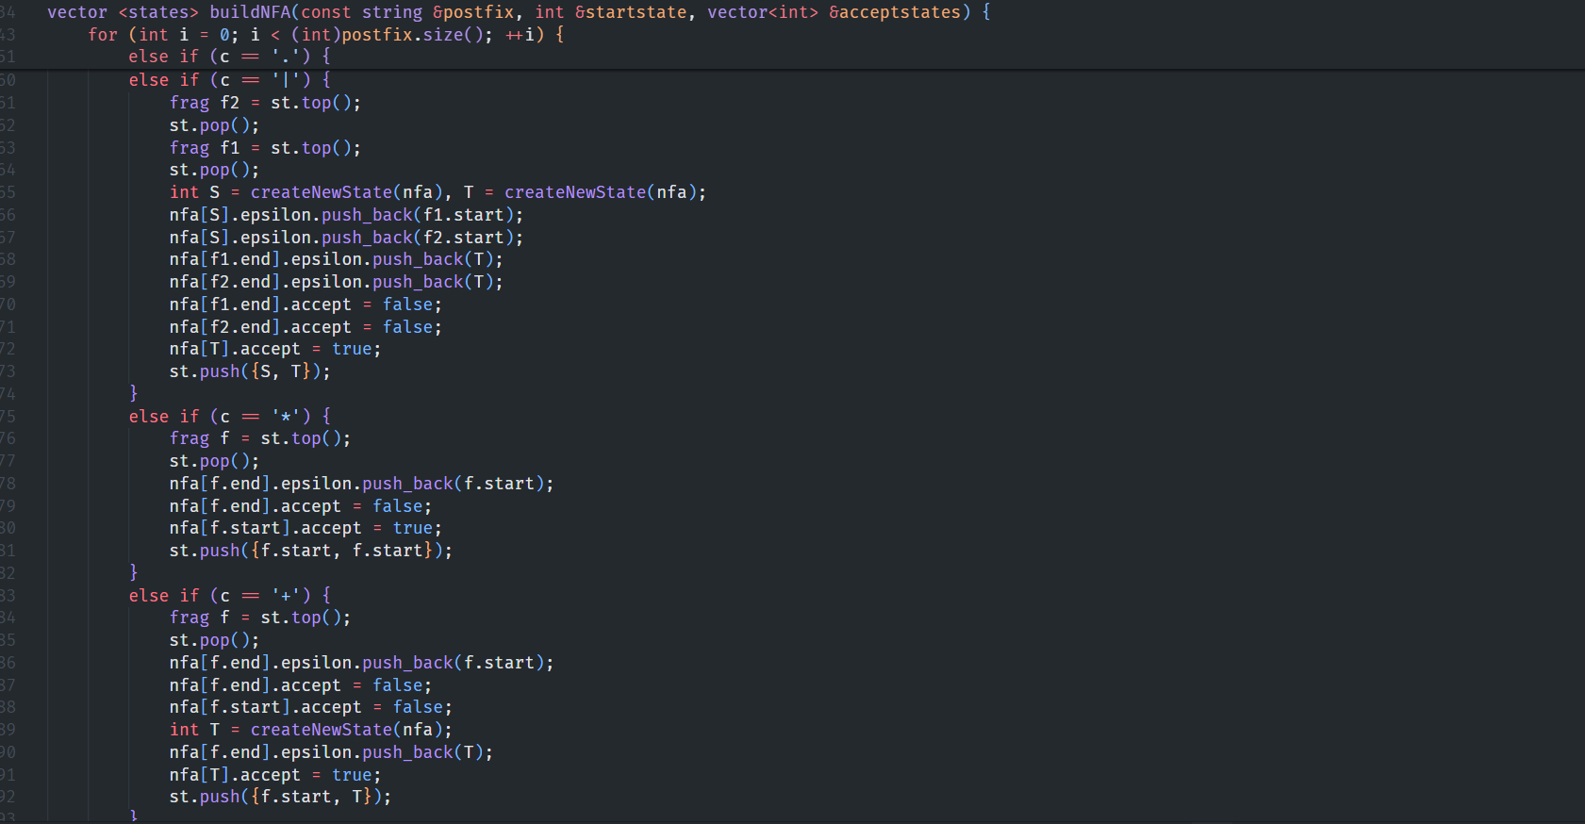

Slide 12
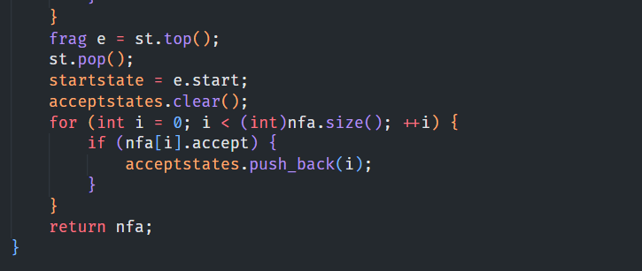

Slide 13
Explanation:
This is the buildNFA function
Its aim is to build a NFA from a regular expression in postfix notation (from infixToPostfix function).
The function uses Thompson’s Construction Algorithm, which builds NFA for simple REs and combines them for complex ones.
The partial, simple NFAs are represented by ‘frag’ structure, as in Fragments, which are pushed in the stack.
The vector contains all states of the final NFA.

Slide 14
Explanation:
First a 2-state NFA is created with ‘s’ – start state, ‘f’ – final state, ‘c’ – transition, which is then pushed to stack.
‘c’ is checked for concatenation, union, Klean star and plus operator, and deals accordingly.
Finally, it retrieves the final NFA from the stack, sets the start state, collects all accepting states, and returns the completed NFA.

Slide 15
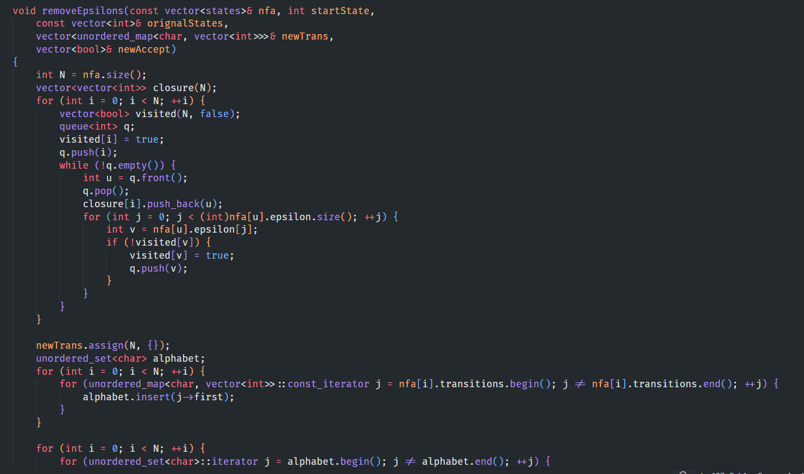

Slide 16
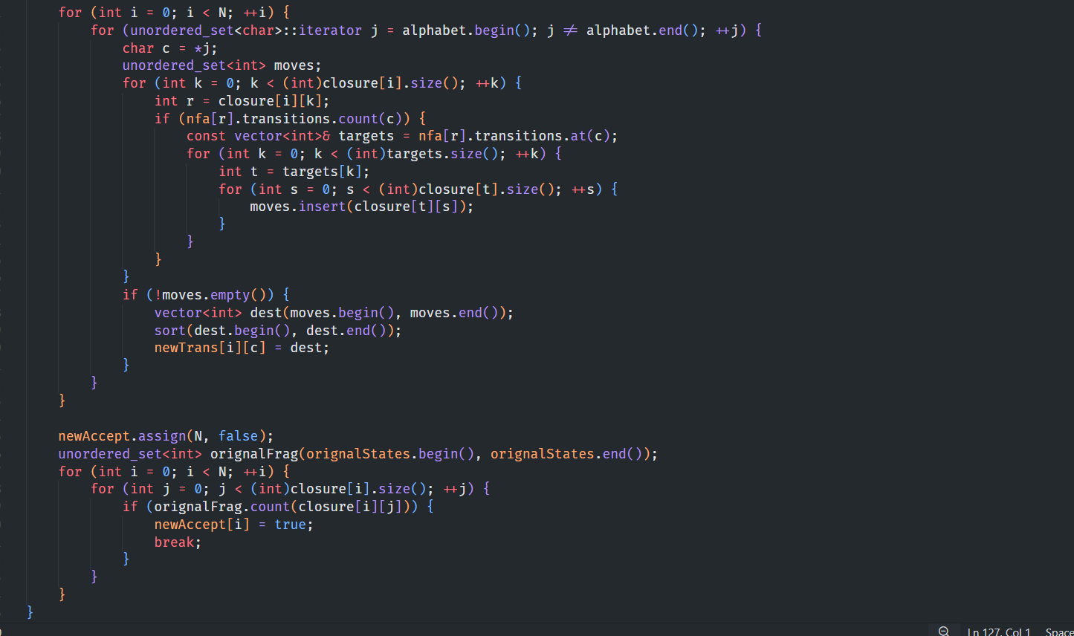

Slide 17
Explanation:
This is the removeEpsilon function
It transforms an NFA with epsilon transitions into an equivalent NFA without epsilon transitions.
For each state, it finds out all the states reachable by following only epsilon transitions (using breadth-first searching).
Then it creates new transitions that removes epsilon transitions.
Marks a state as accepting if any accepting state is reachable from it using only epsilon transitions.

Slide 18
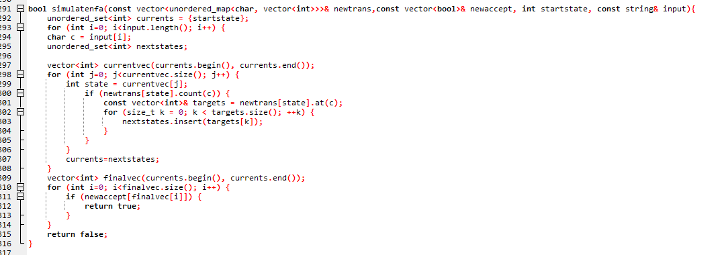

Slide 19
Explanation:
This is simulate nfa function. The purpose of this function is to simulate NFA without epsilon transitions and check if it accepts a given input string. This function takes the input string and the cleaned NFA (transition table and accepting states).Starts from the initial state and tracks all possible current states at each step. For every character in the input string, finds all valid transitions from current states. Updates current states to next reachable states. After processing the entire string, checks if any current state is accepting. Returns true if accepted, otherwise false.

Slide 20
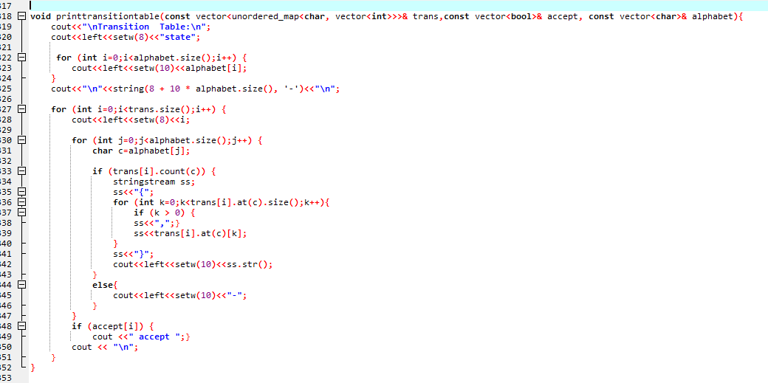

Slide 21
EXPLANATION:
This is simulate nfa function. The purpose of this function is to display the transitions and accepting states of the NFA. This function Loops through each state and prints transitions for every symbol, shows destination states that can be reached from each state-symbol pair and also prints the list of accepting states.

Slide 22
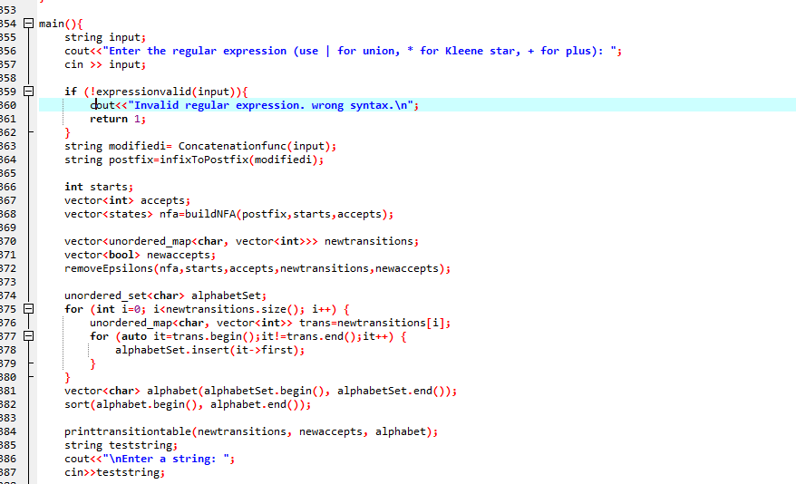

Slide 23
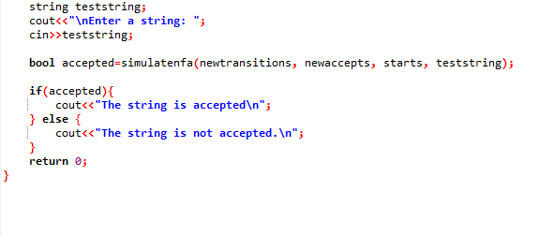

Slide 24
EXPLANATION:
This is the main function. The prupose of this function is to coordinates the full process of simulating an NFA from a regular expression and checking if a string is accepted. In the main
1.Takes Regular Expression as .
2.Convert to Postfix Notation. By Using infixToPostfix() function.
3.Build NFA from PostfixCalls. By using buildNFA() function using Thompson's construction.Builds NFA structure with possible ε-transitions.
4.Remove Epsilon Transitions. By using removeEpsilon() function to clean the NFA and produces a transition table without ε-moves and updated accepting states
5.Prints the transition table by calling printtranstiontable function
6. Takes input string and check this by simulatenfa function

Slide 25
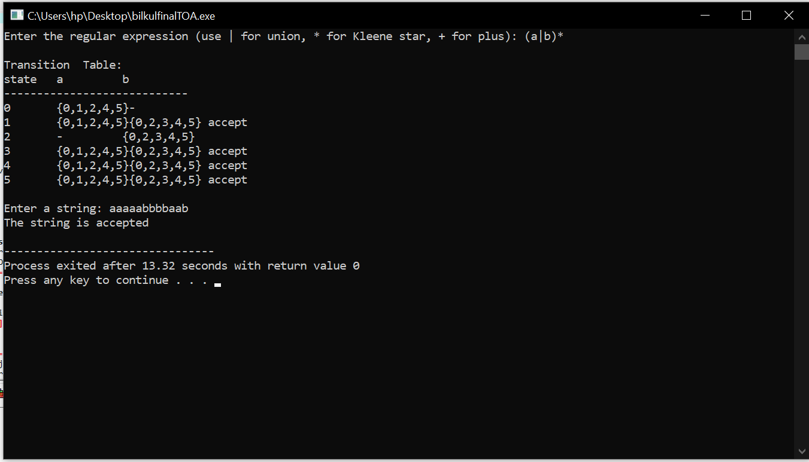

Slide 26
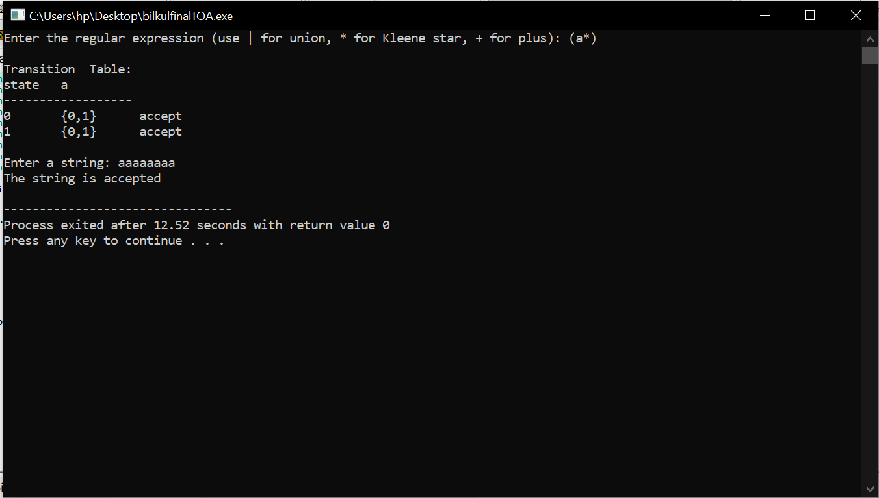

Slide 27
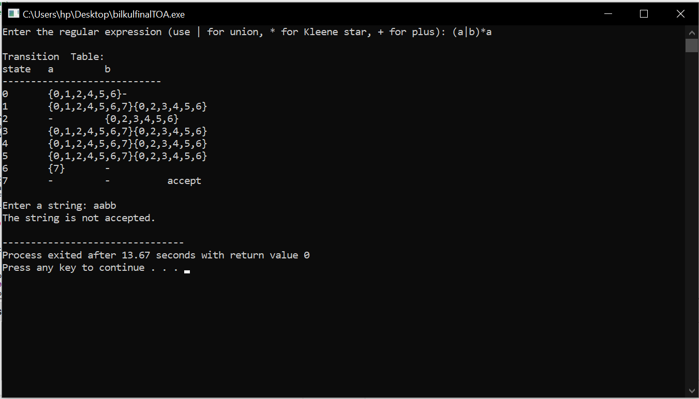

Slide 28
OUTPUTS:
We tested the program on 3 regexes, (a|b)* , (a*), (a|b)*a
For (a|b)*, this accepts any, and repeated occurrences of a or b, hence accepted on aaaaabbbbaab.
For (a*), this accepts no, or repeated occurrences of a, hence accepted on aaaaaaaa.
For (a|b)*a, this accepts any string with any occurrences of a or b, provided that it ends with a, hence rejected on aabb.

Slide 29
Thank YOU! References Hopcroft, Motwani, Ullman – Introduction to Automata Theory, Languages, and Computation Introduction-to-computer-theory-by-Cohen C++ STL Documentation Online resources and tutorials on NFAs and epsilon closures
Mohid Raheel khan (23k-300-)
Hassan Nafees (23k-0769)
Aaqib Shivji (23k-0625)

